Slide 1
Realising Testing Value Through Deployment Pipelines

Slide 2
Suman

Slide 3
Ash

Slide 4
Y tho?
Building anything is constrained by your ability to deploy safely…

Slide 5
Y tho?
Pipelines facilitate balanced testing, giving a varied view of quality.

Slide 6
Y tho?
Time taken to start testing increases with unreliable deployments

Slide 7
Y tho?
New ways to contribute as testers in a changing world

Slide 8
Be excellent to each other
Code of conduct
Ask questions now, deep dive later.
Help those around you, varied experience in the room.
Technical problems? Flag them and share.

Slide 9
Exercises
Recognising pipeline technology and terminology

Slide 10
Exercises
Building a multi stage pipeline in Jenkins

Slide 11
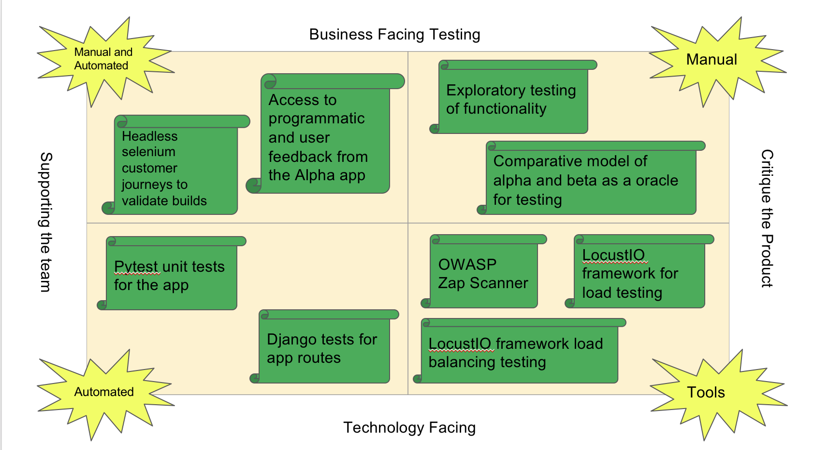
Exercises
Principles of building a pipeline to facilitate balanced testing

Slide 12
Check in
Based on reading the abstract and pre-requisites.
Confidence out of 10, on the scale.
> 8 make yourselves known!

Slide 13
Questions before we start?

